Slide 1
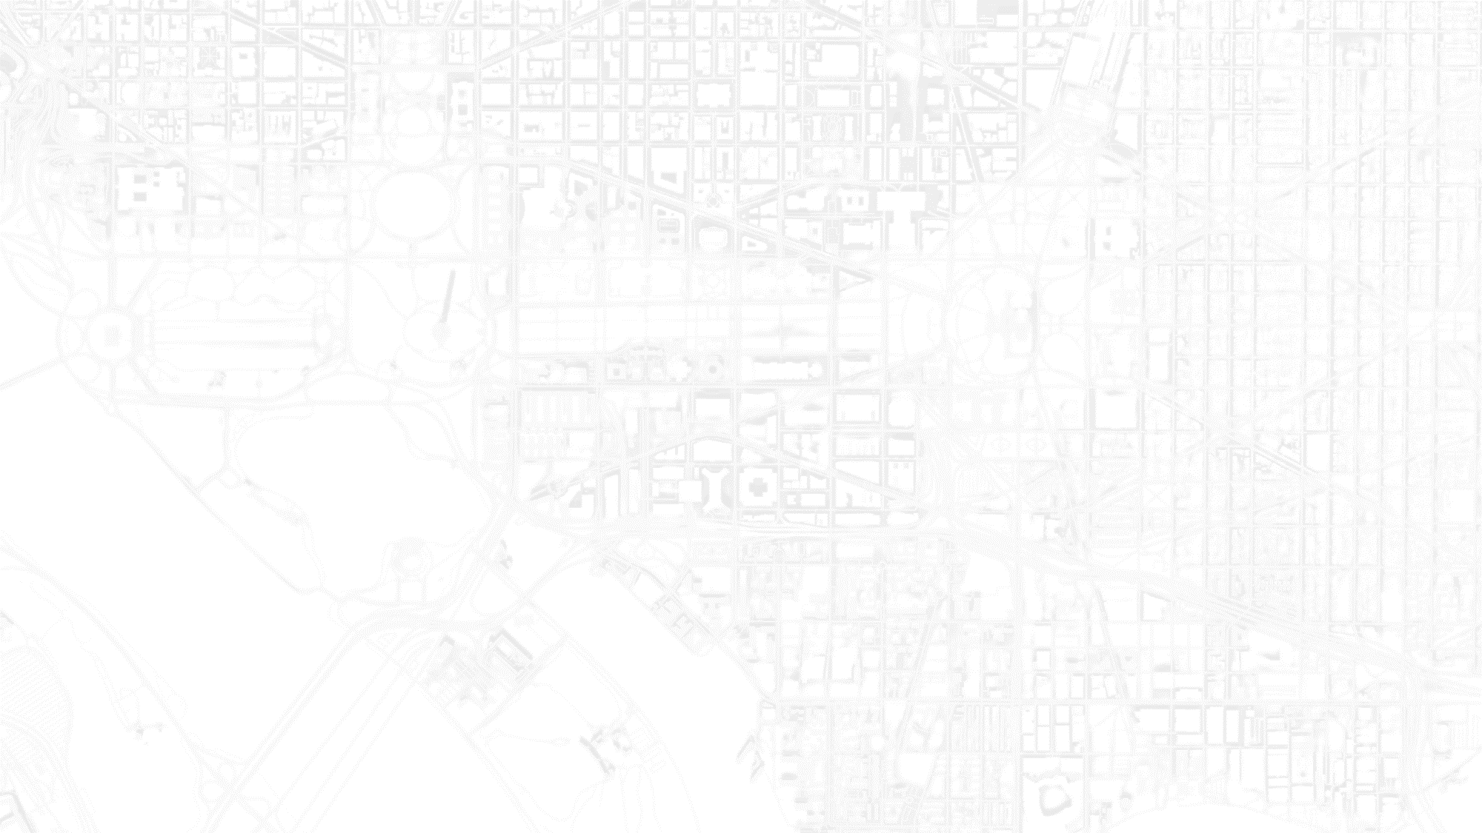
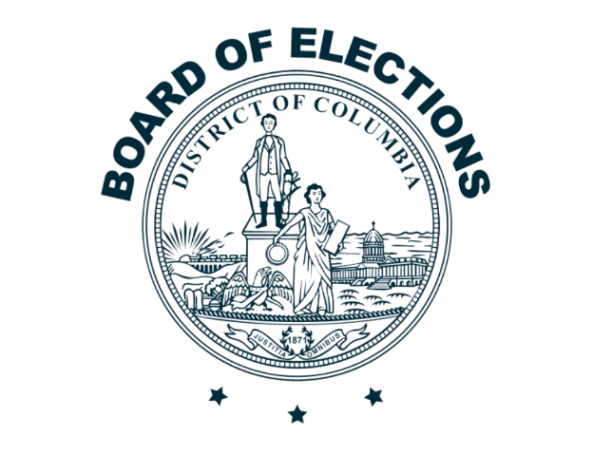
PREPARING FOR THE 2026 GENERAL ELECTION
WITH RANKED CHOICE VOTING
WWW.DCBOE.ORG

Slide 2
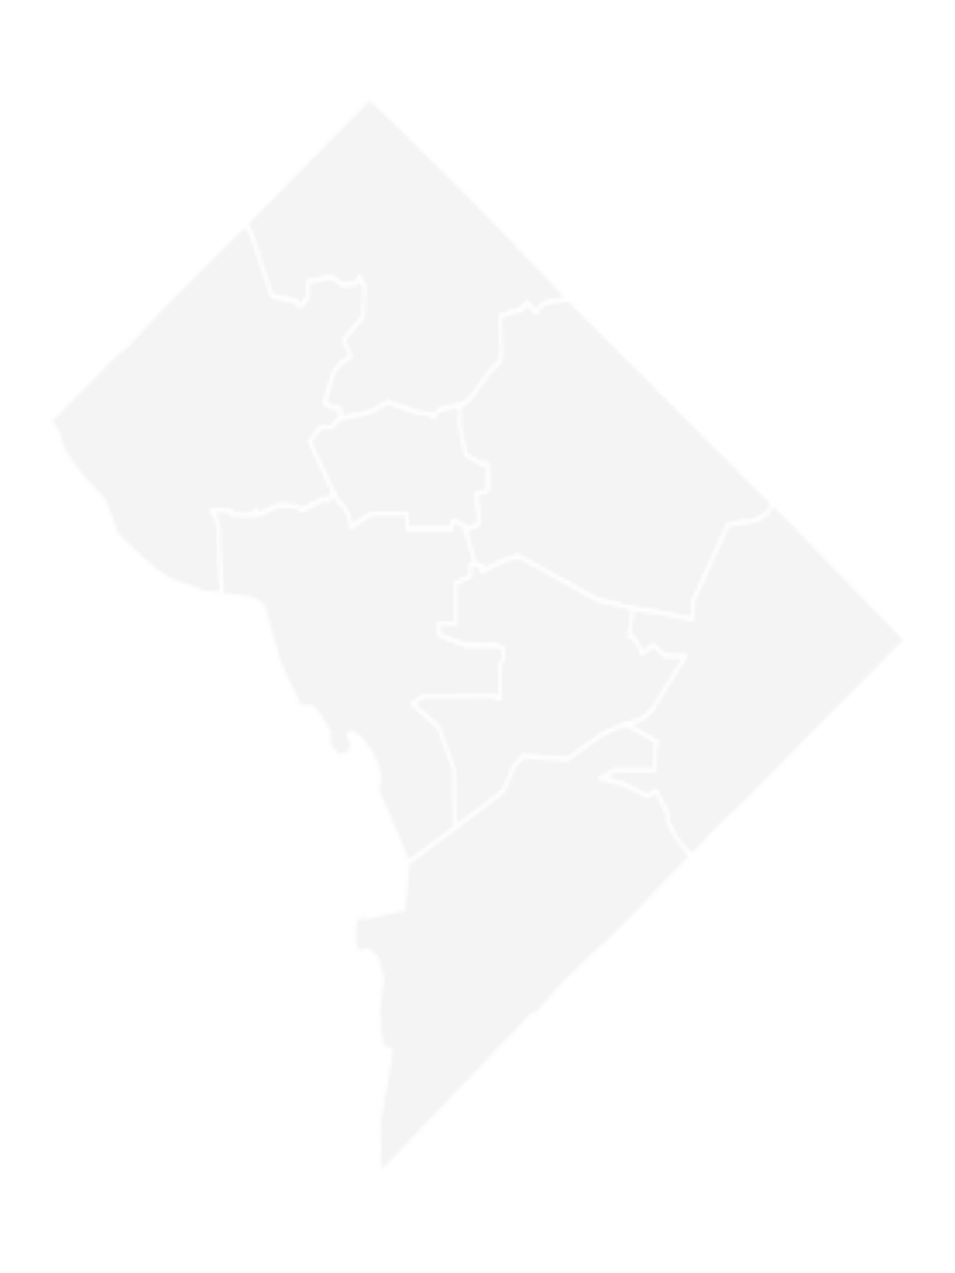

AGENDA
Welcome
Ranked Choice Voting (RCV) Review
Preparing for the General Election
AVR – Automatic Voter Registration
Important Dates
Available Resources
Questions and Answers
WWW.DCBOE.ORG

Slide 3
WEBINAR INSTRUCTIONS
There will be a question-and-answer session at the end, but feel free to submit a question at any time using the “Q&A” feature on the meeting control panel.
To ask a question using the Q&A function:
  Type your question into the Q&A box. Click Send.
    Note: Check “Send Anonymously” if you do not want your name attached to your question in the Q&A.
WWW.DCBOE.ORG

Slide 4
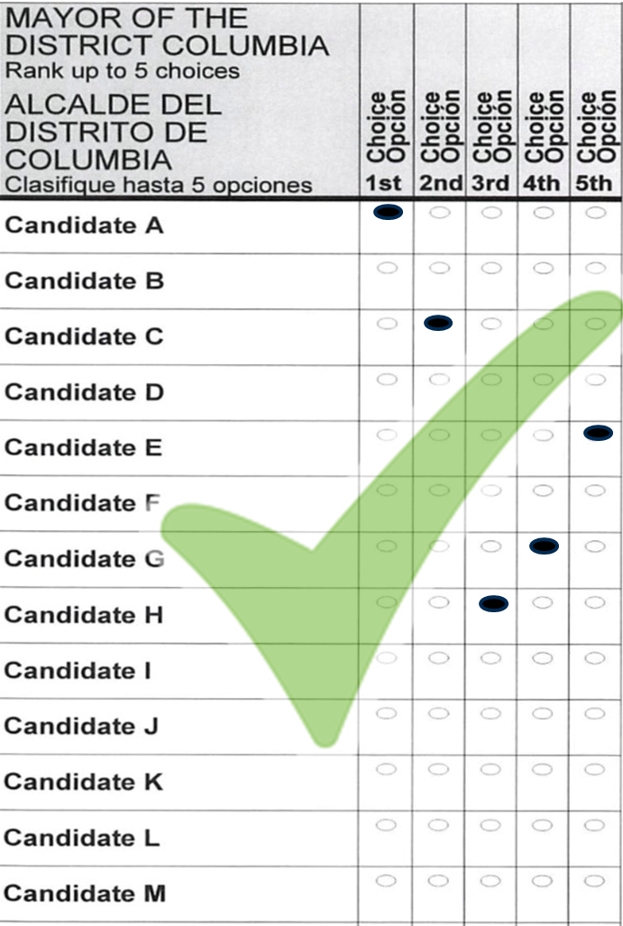
RCV REVIEW
HOW TO MARK YOUR BALLOT
Fill in only one oval per column.
Rank up to five candidates.
Ranking additional candidates does not harm your 1st choice.
Voters are not required to rank candidates. Voters may select one candidate if they choose to.

Slide 5
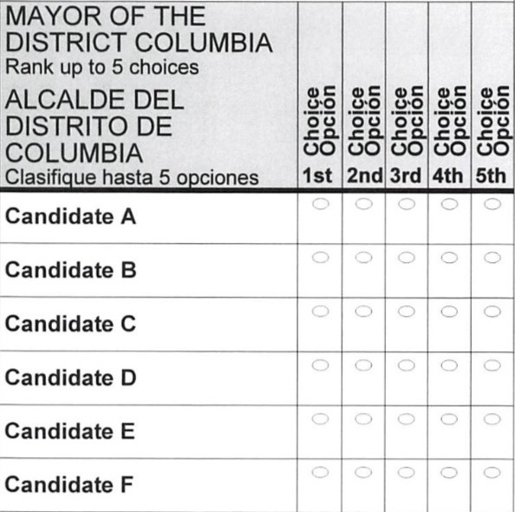
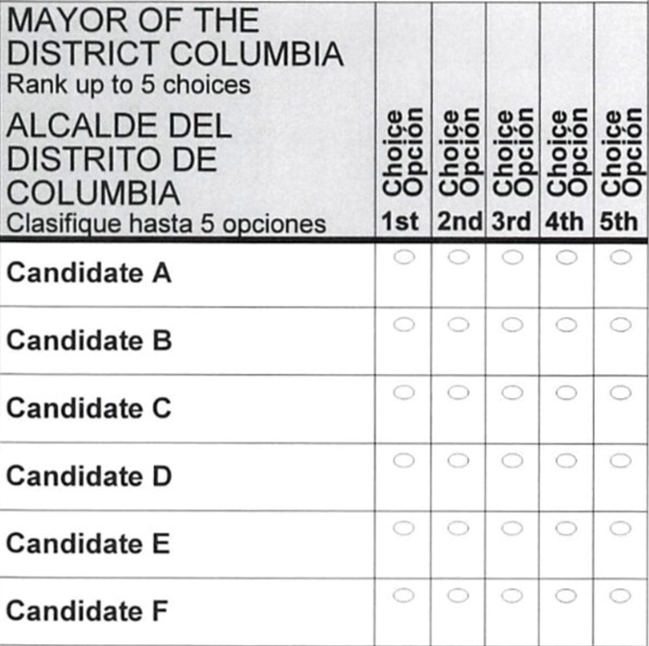
MISTAKES TO AVOID:
RANKING ERRORS
WWW.DCBOE.ORG

Slide 6
MISTAKES TO AVOID:
SKIPPING
WWW.DCBOE.ORG

Slide 7
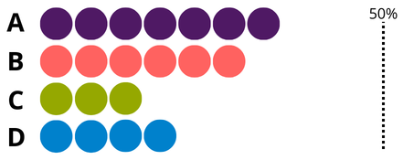
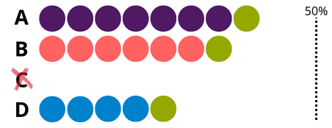

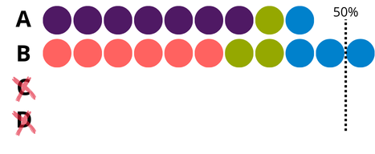
Round 1
TABULATION PROCESS
First choices are counted.
Round 2
The candidate with the fewest votes is eliminated. Those ballots are transferred to the voter’s next choice.
B
Round 3
This process continues until a candidate reaches a majority.
WINS

Slide 8
WHAT’S ON YOUR 2026 GENERAL ELECTION BALLOT
Mayor of the District of Columbia
Attorney General
Chairman of the Council of the District of Columbia
At-Large Member of the Council of the District of Columbia
Members of the Council of the District of Columbia (Wards 1,3,5 & 6)
Member of the State Board of Education (Wards 1,3,5 & 6)
Delegate to the United States House of Representatives
United States Senator
United States Representative
Advisory Neighborhood Commissioner
WWW.DCBOE.ORG

Slide 9
AVR
Automatic Voter Registration
What is Automatic Voter Registration (AVR)?
Activate registration
  Return notification
  Return your mail ballot
  Register to vote online
  Register at BOE Headquarters
  Register at a Vote Center
WWW.DCBOE.ORG

Slide 10



WAYS TO VOTE
MAIL
EARLY VOTING
ELECTION DAY
55 Drop Box locations open October 9 – November 3
25 Vote Centers open October 26 – November 1
75 Vote Centers open November 3
WWW.DCBOE.ORG

Slide 11
IMPORTANT 2026 GENERAL ELECTION DATES
The week of September 28 – October 2
  DCBOE will begin mailing ballots
Friday, October 9 – Tuesday, November 3
  55 Mail Ballot Drop Boxes are Open
Tuesday, October 13
  Deadline for the receipt of voter registration applications submitted by mail or online
Monday, October 26 – Sunday, November 1
  25 Early Voting Vote Centers will be open from 8:30 am – 7:00 pm
WWW.DCBOE.ORG

Slide 12
IMPORTANT 2026 GENERAL ELECTION DATES
Tuesday, November 3 – ELECTION DAY
  75 Vote Centers will be open from 7:00 am – 8:00 pm
  As long as you are in line by 8:00 pm, you can vote
Friday, November 13
  Mail-ballot receipt deadline
Wednesday, December 2
  Certification of election results
WWW.DCBOE.ORG

Slide 13

2026 GENERAL ELECTION FAQS
My mail ballot never arrived. What should I do?
I made a mistake on my ballot. What are my options?
I received a mail ballot but want to vote in person. What should I do?

Slide 14
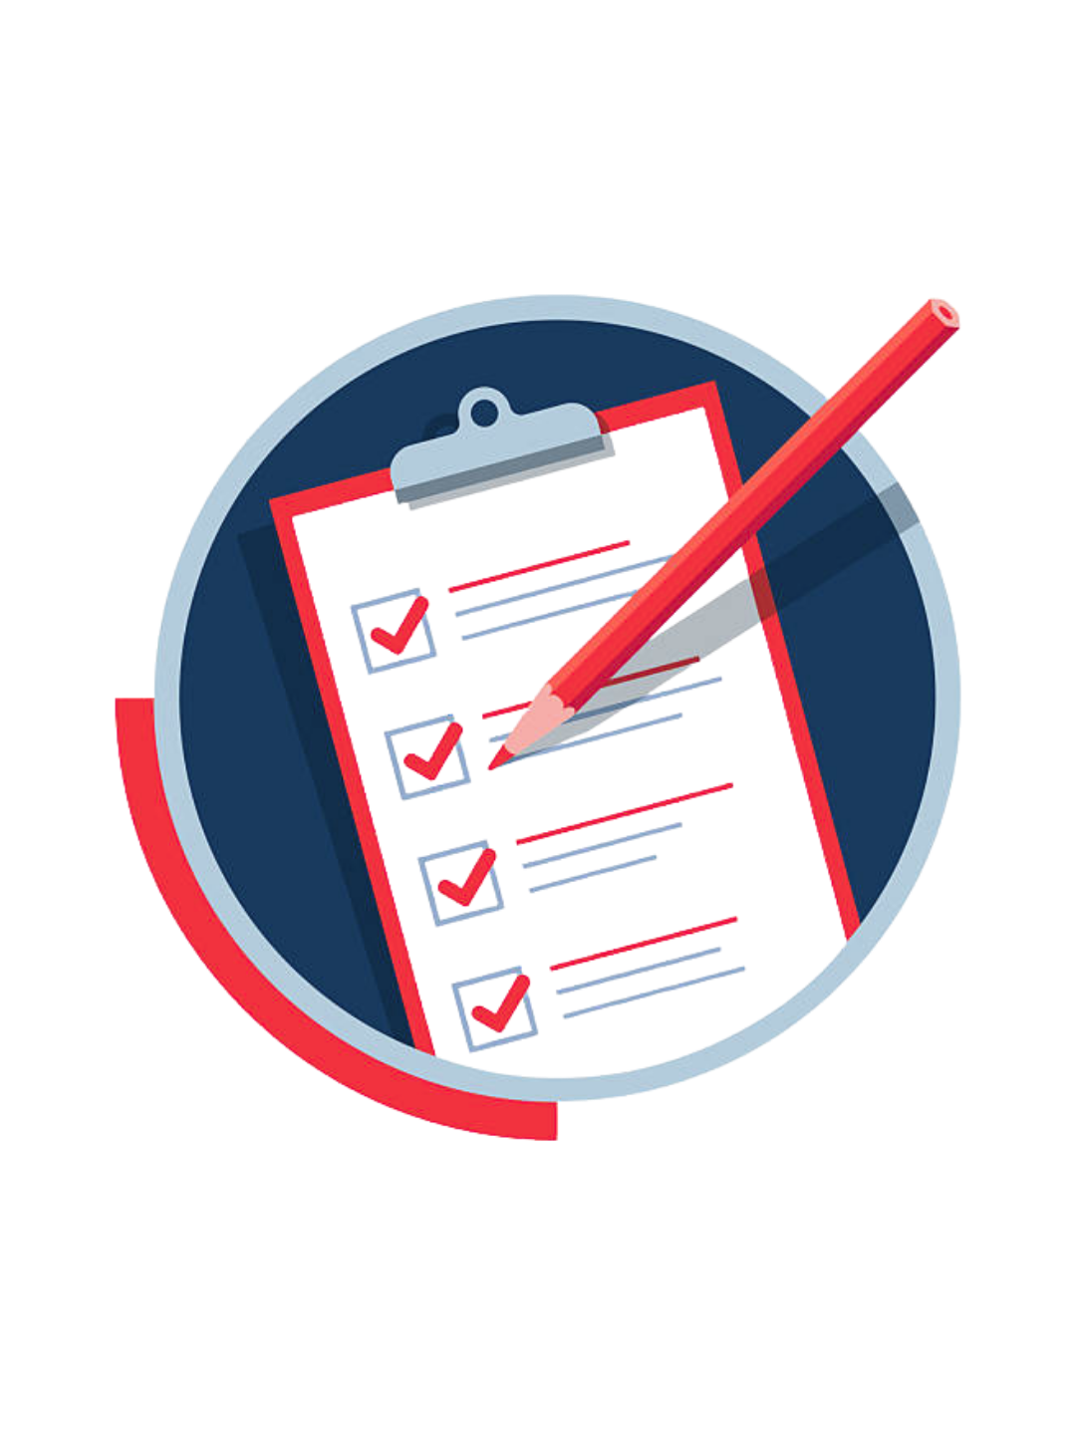
2026 GENERAL ELECTION CHECKLIST
Check your voter registration
Decide how you want to vote
Review/mark a sample ballot
Know the deadlines
Locate a Vote Center or Drop Box
WWW.DCBOE.ORG

Slide 15
TRUSTED SOURCE OF VOTING INFORMATION
Phone: (202) 727-2525
Website: www.dcboe.org/rcv
X: @Vote4DC
Facebook.com/Vote4DC
Instagram@Vote4DC
Outreach Division: outreach@dcboe.org
WWW.DCBOE.ORG

Slide 16
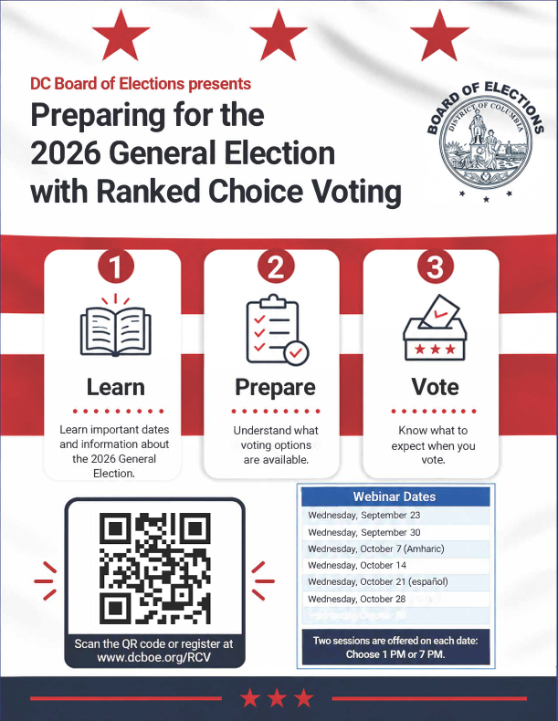
UPCOMING WEBINAR DATES
  ALL webinars are at 1pm and 7pm
  Wednesday, September 30
  Wednesday, October 7 (Amharic)
  Wednesday, October 14
  Wednesday, October 21 (español)
  Wednesday, October 28
  Register at www.dcboe.org/RCV

Slide 17
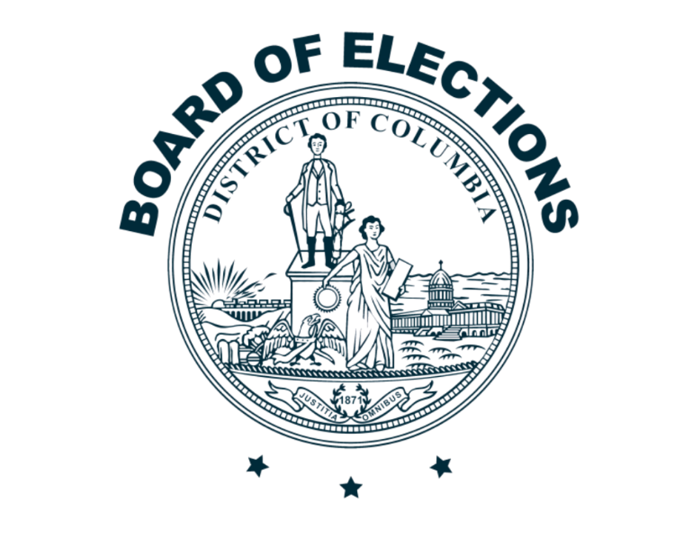
THANK YOU
For more information about speaking engagements, contact:
Outreach@dcboe.org
WWW.DCBOE.ORG

