Slide 1

Ranked choice voting
2026 implementation information
Webinar series

Slide 2

Agenda
Introduction and Instructions
What is RCV?
How Does RCV Work in DC?
How to Mark Your Ballot and Mistakes to Avoid
Tabulation Process
What to Expect on Election Day
Available RCV Resources
Important Primary and Special Election Dates
Questions and Answers

Slide 3
Webinar instructions
There will be a question and answer session at the end, but feel free to submit a question at any time using the “Q&A” feature on the meeting control panel.
To ask a question using the Q&A function:
Type your question into the Q&A box. Click Send.
Note: Check “Send Anonymously” if you do not want your name attached to your question in the Q&A.

Slide 4
Webinar Instructions
To ask a question during the Q&A:
Raise your “hand” and wait to be recognized.
You will be asked to unmute and then you can ask your question.
We may not have time to answer all questions. If you desire a follow-up, email DCBOE at rcv@dcboe.org.
Important Reminders:
The DC Board of Elections is an independent, non-partisan agency and cannot offer opinions or answer questions that are partisan in nature.
Please engage respectfully.
Kindly hold comments until you are recognized. We will address as many questions as possible.

Slide 5

Ranked choice voting (rcv) in the district of columbia
RCV is Here!
In the November 2024 General Election, voters overwhelmingly voted for Initiative Measure No. 83 (I83), a voter initiative that established RCV as a voting method in DC
The DC Council funded RCV in the FY 2026 budget
DC Board of Elections (DCBOE) will implement RCV in all elections that we administer beginning with the June 16, 2026 Primary and Special Elections

Slide 6
Ranked choice voting (rcv) in the district of columbia
PRIMARY, GENERAL ELECTIONS, & SPECIAL ELECTIONS
President and Vice President of the United States;
Mayor of the District of Columbia;
Attorney General;
Chairman of the Council of the District of Columbia;
Delegate to the United States House of Representatives;
Members of the Council of the District of Columbia;
Members of the State Board of Education;
United States Senator;
United States Representative; and
Advisory Neighborhood Commissioner.

Slide 7
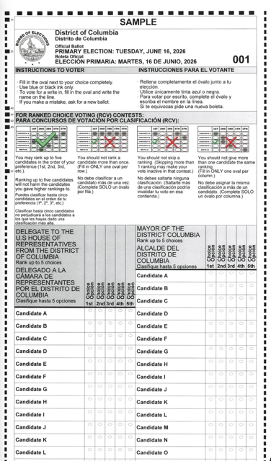
What is rcv AND HOW DOES IT WORK?
Please note that there are many RCV models. The model of RCV that is being implemented in DC was determined by the text of I83, not by DCBOE.
DCBOE is responsible for drafting regulations that align with the legislation.
RCV will apply to each contest that contains at least three qualified ballot access candidates.
In RCV contests, voters may rank candidates in order of preference instead of choosing only one.
Ballots are counted in rounds until a candidate receives a majority of votes (at least 50%).

Slide 8
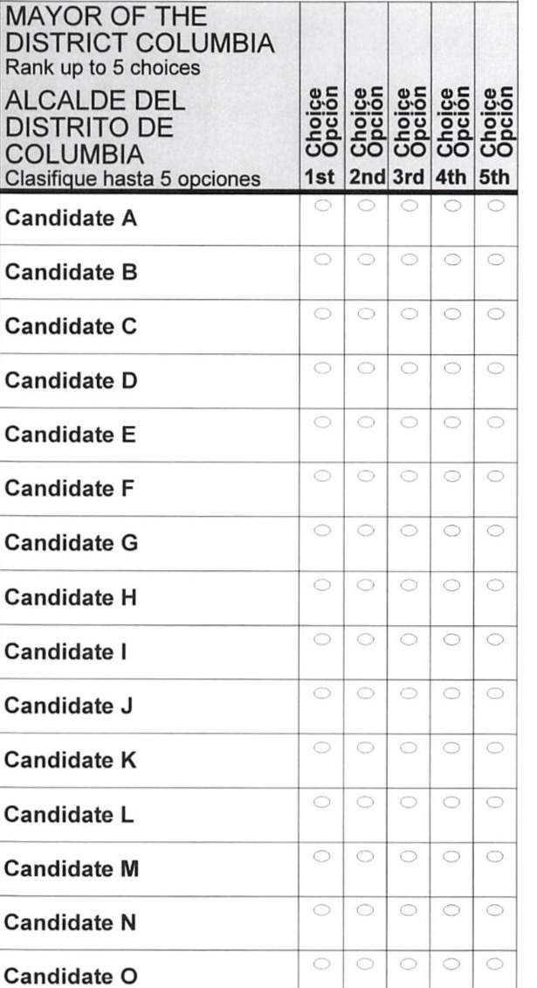

How to mark your ballot
Fill in only one oval per column
Rank up to five candidates
Ranking additional candidates does not harm your 1st choice
Voters are not required to rank candidates. Voters may select one candidate if they choose to do so.

Slide 9
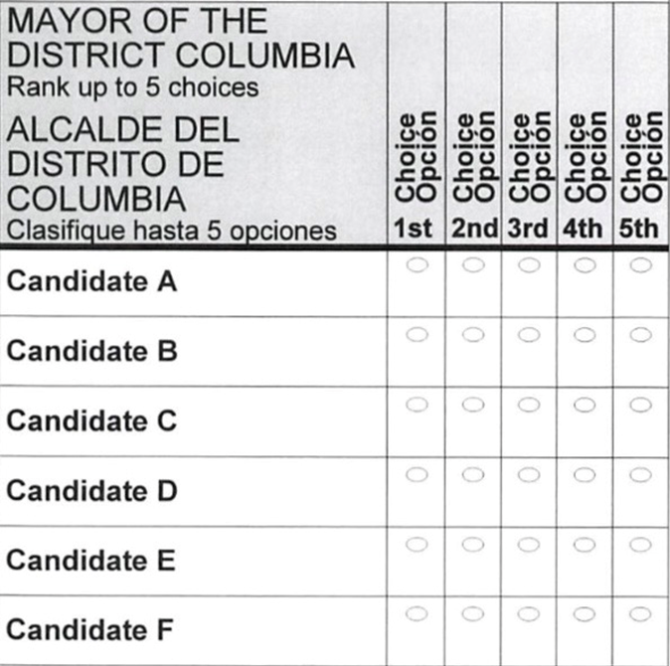
Mistakes to avoid – ranking errors

Slide 10
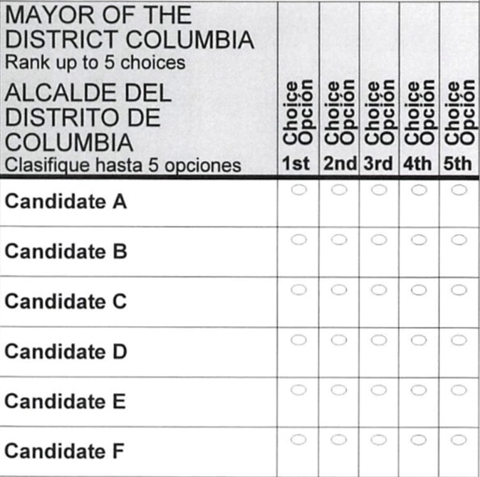
Mistakes to avoid - skipping

Slide 11
Please Note
If no candidate receives over 50% of the votes in a contest, we will begin the RCV tabulation process.
During each tabulation round, the candidate with the fewest votes is removed from the ballot.
Even though you are ranking up to five (5) candidates in a contest, only one vote is valid at a time.
Once you select your first candidate, your vote stays with your top-ranked candidate as long as that candidate remains active.

Slide 12
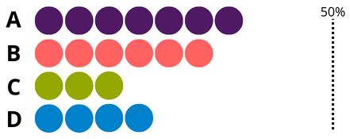
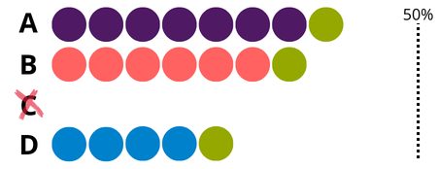

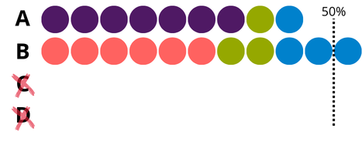
Round 1
TABULATION PROCESS
First choices are counted.
Round 2
The candidate with the fewest votes is eliminated. Those ballots are transferred to the voter’s next choice.
B
Round 3
This process continues until a candidate reaches a majority.
WINS

Slide 13
What should you expect?
Voting
Results
It may take longer to mark your ballot
Guidance on RCV will be available at Vote Centers
Mail Ballot packets will include guidance on RCV
Results reports will look different from reports in previous elections
Getting best practices from other jurisdictions
Transparency is key
Results will still be available on DCBOE website
The results reporting schedule will be different from previous elections
Schedule is being determined
Preliminary results will still be posted on Election Night

Slide 14

Education & outreach
Coming Soon
Available Resources
RCV page on DCBOE website
Election tabulation simulator tool
Explanation Video
FAQs
Resource Lab at DCBOE
Palm cards
In-person and virtual speaking engagements
Voter Guide
Mailers

Slide 15
Important June 16, 2026 Primary and Special Election dates
Monday, May 11, 2026
DCBOE will begin mailing ballots to all eligible registered DC voters.
Friday, May 22, 2026 – Tuesday, June 16, 2026 at 8:00 pm
55 Mail Ballot Drop Boxes are Open
Tuesday, May 26, 2026
Deadline for registered voters to change party affiliation status and for the receipt of voter registration applications submitted by mail or online
Monday, June 8, 2026 – Sunday, June 14, 2026
Early Voting Vote Centers will be open from 8:30 am – 7:00 pm.
Tuesday, June 16, 2026 – ELECTION DAY
Vote Centers will be open from 7:00 am – 8:00 pm.
As long as you are in line by 8:00 pm, you can vote.
All ballots sent via the US Postal Service must be postmarked by Tuesday, June 16, 2026 and received by Friday, June 26, 2026 to be counted.

Slide 16
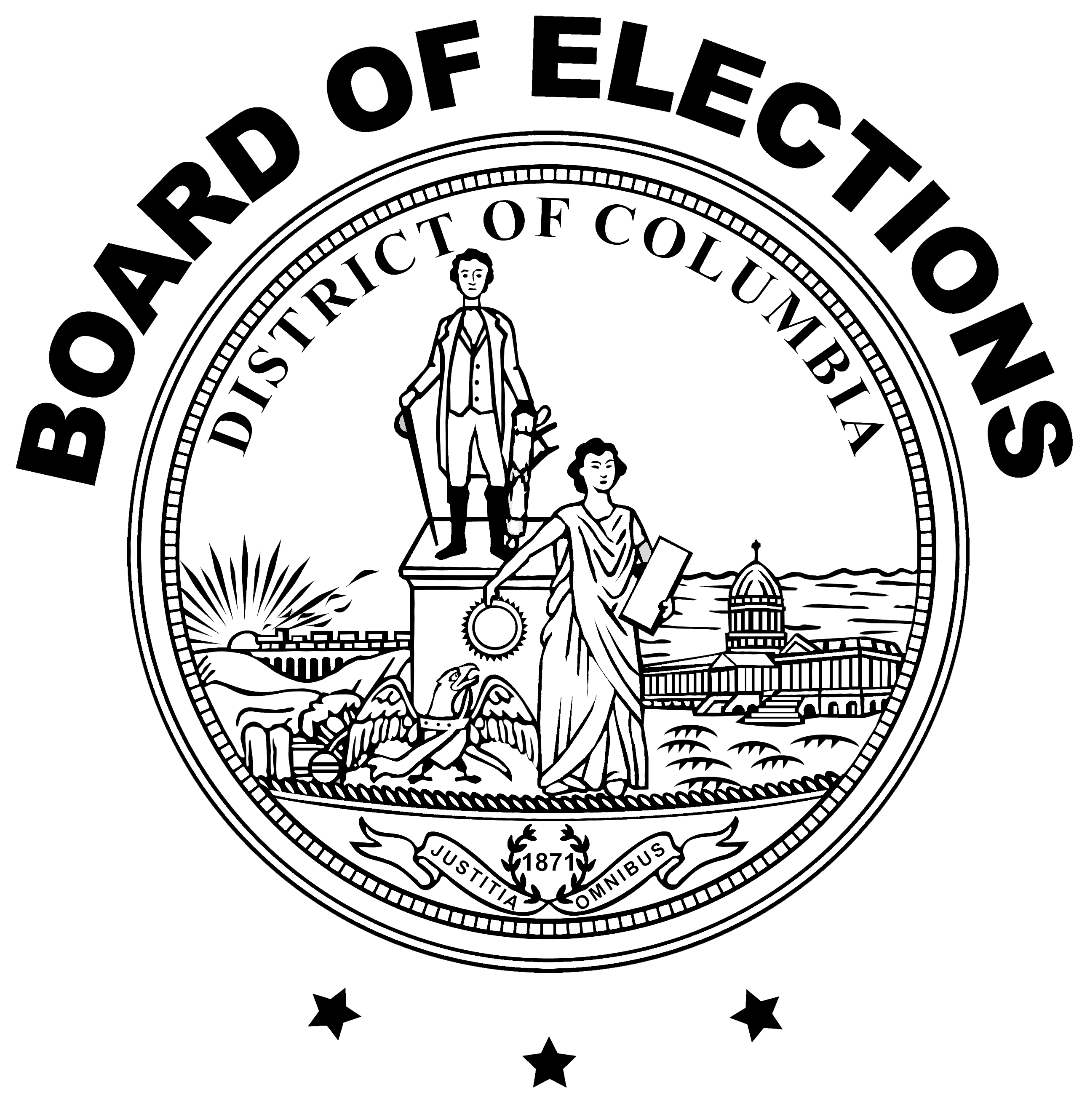
www.dcboe.org
For more information about speaking engagements, contact:
Outreach@dcboe.org

